Slide 1

PhotShare
A FULL STACK PROJECT

Slide 2
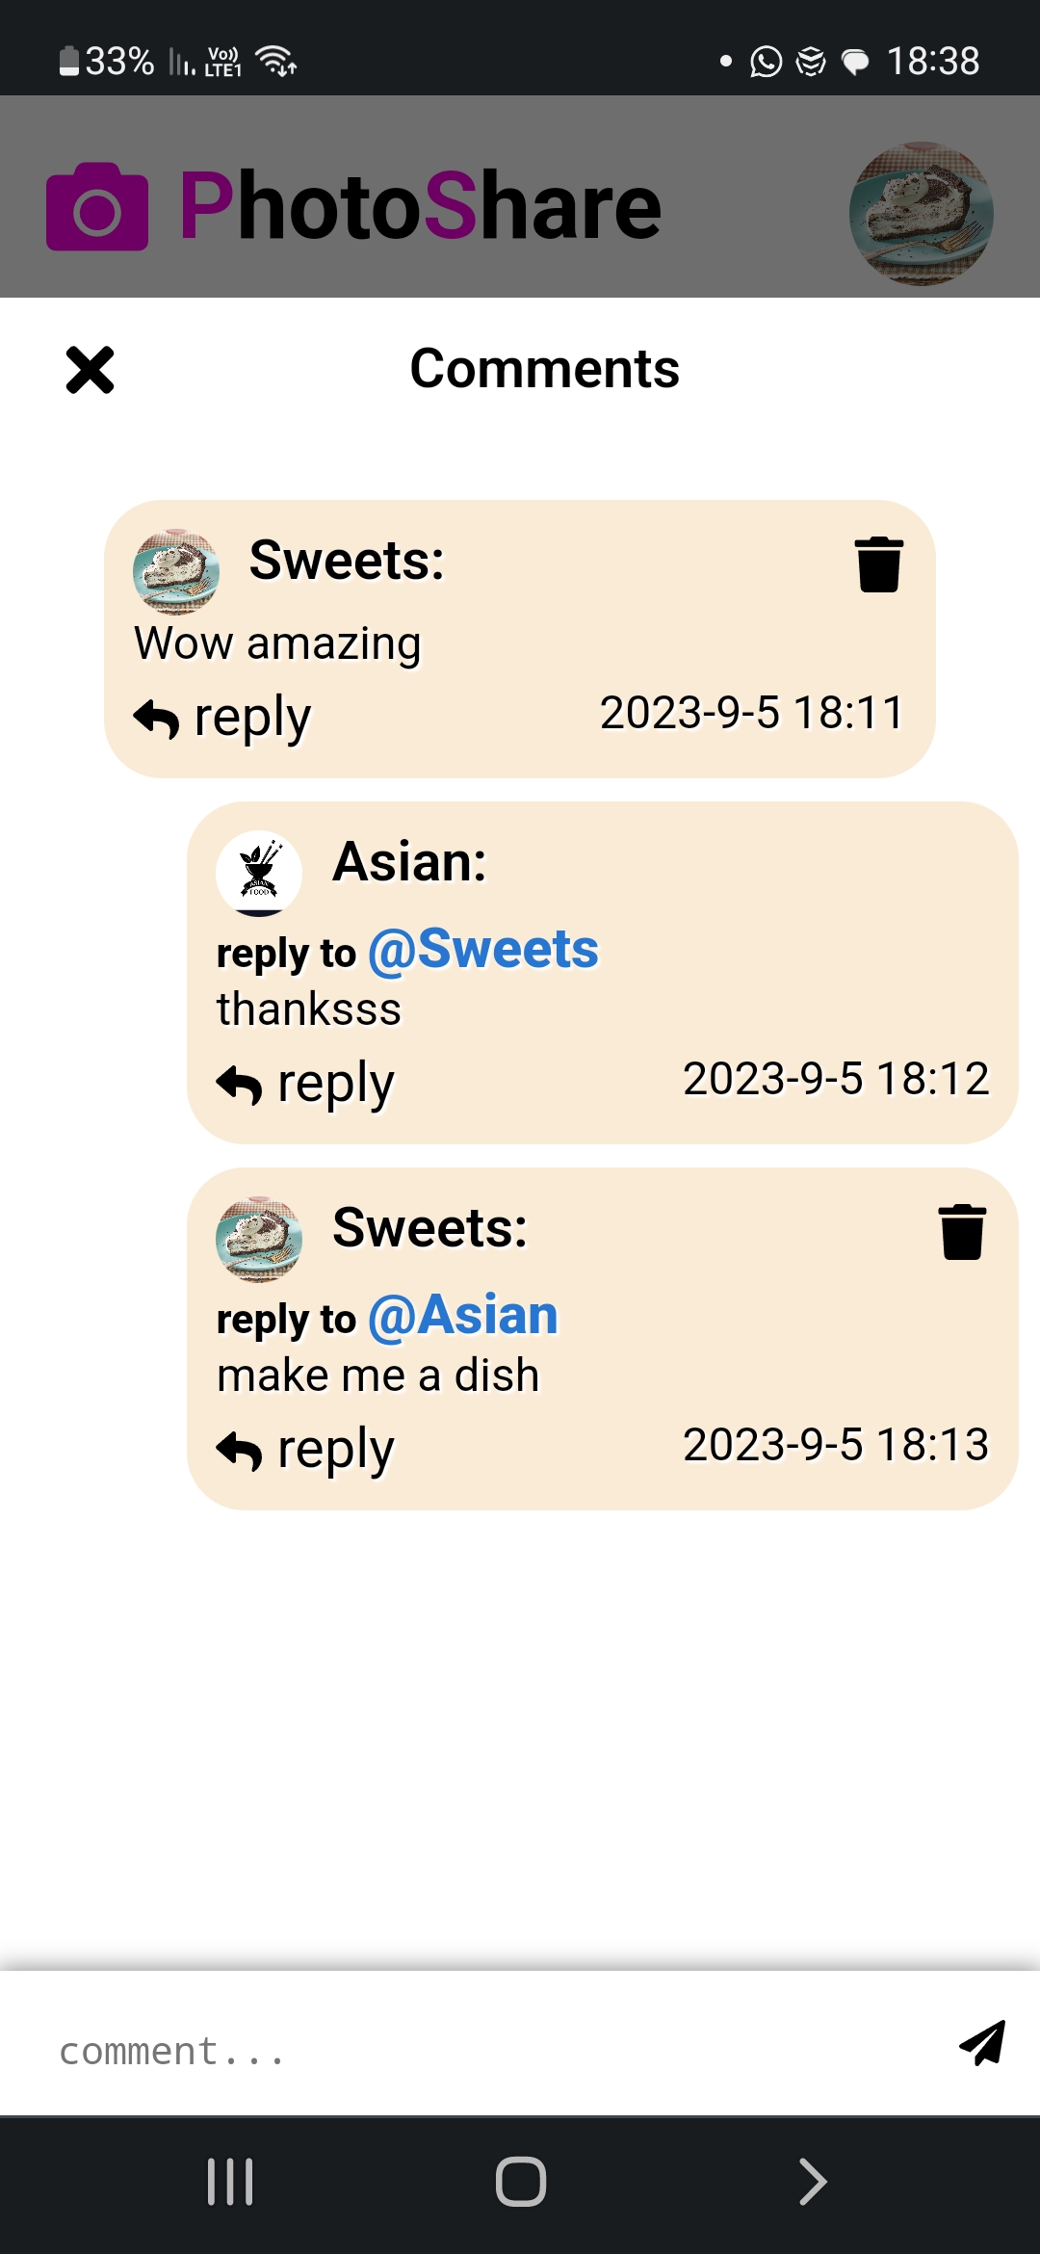
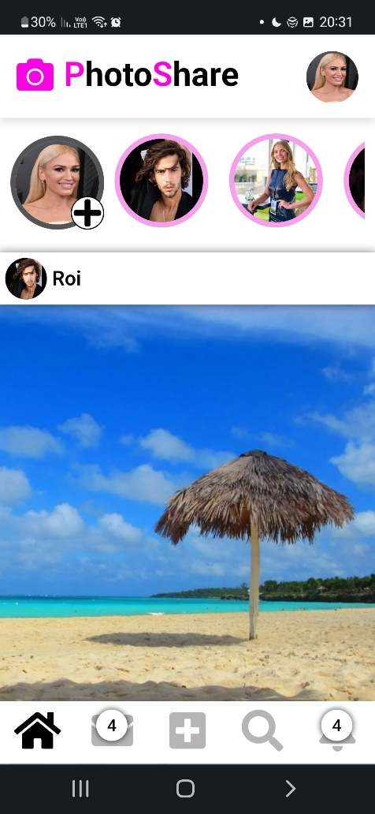

A social network for real-time photo sharing, chatting and much more

Slide 3
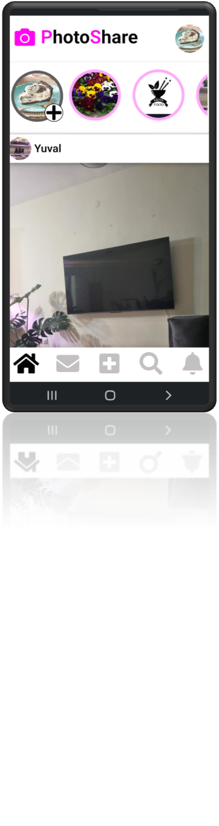
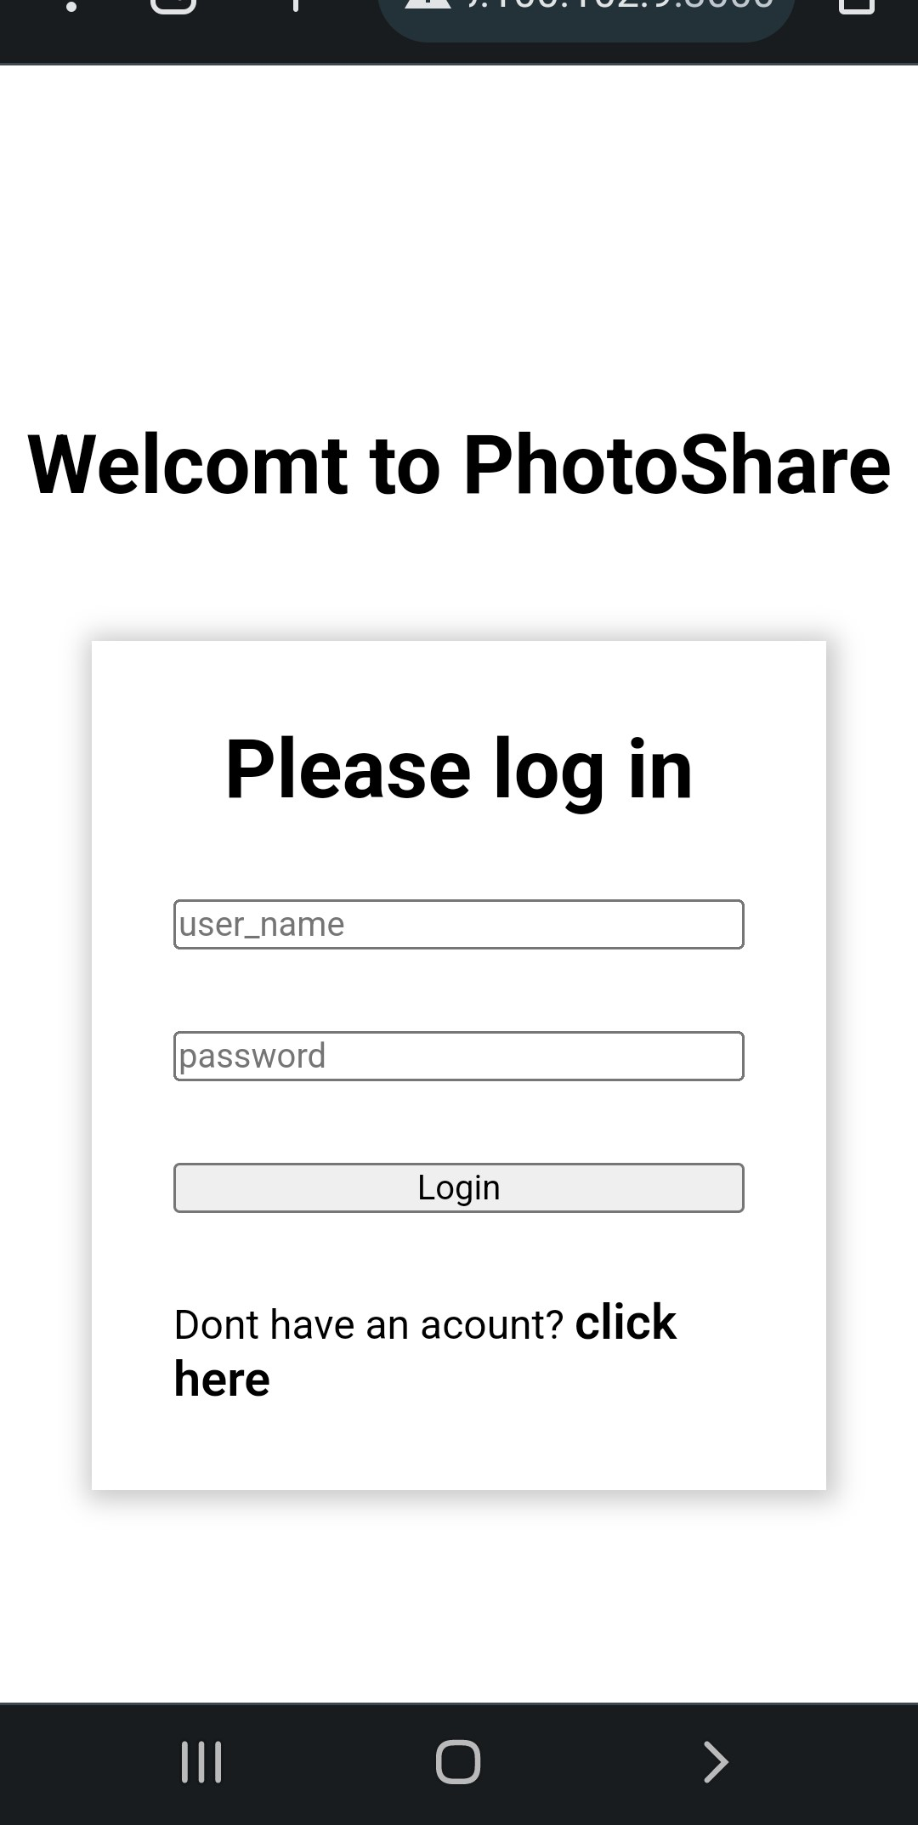
Log In Page
When a user first accesses the web, this is the page he sees.
Each user must sign-in or register if they don't already have one.

Slide 4
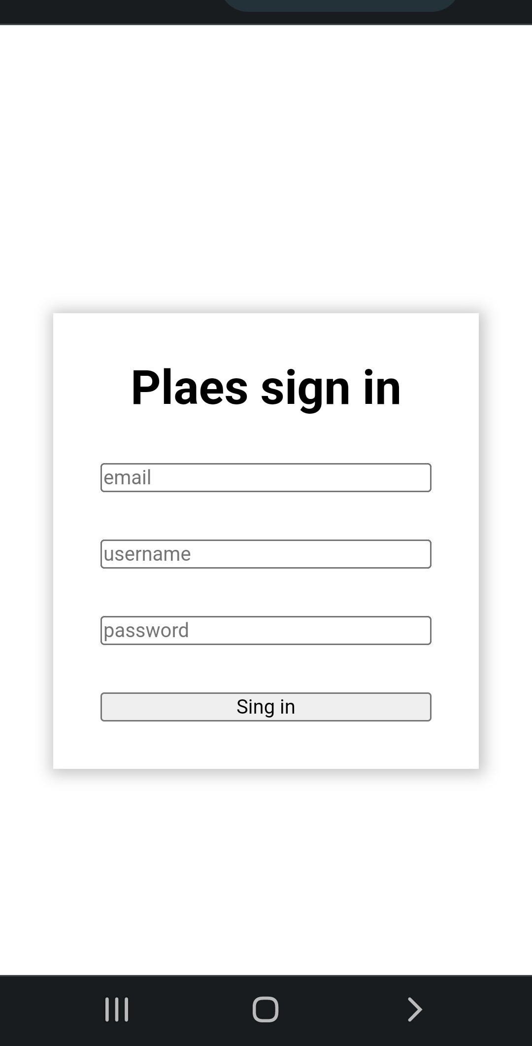
Sign In Page
If the chosen username is already taken when the user submits his details to create a new user, the website will alert them and prevent the creation of the new user
Once the new user has been successfully created, they will get a joining email and be sent to the login page

Slide 5
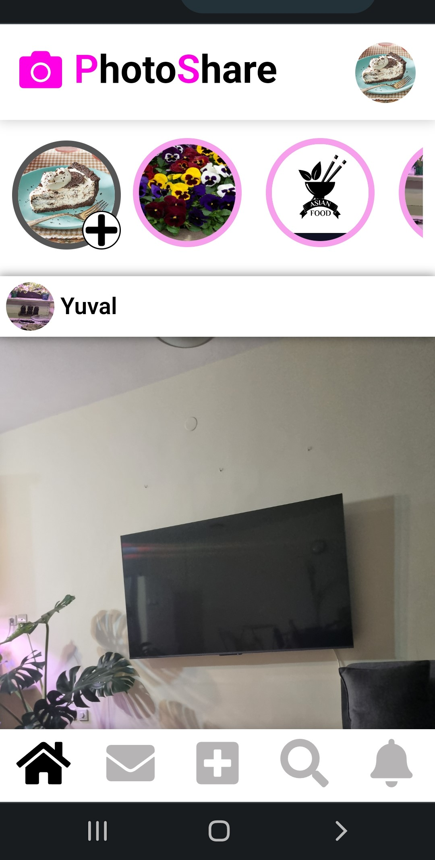




Home Page
After a user has successfully connected to the site, he sent to the home page.
At this page the user as access to two main features of the “PhotoShare” social network and two bars
Menu bar – contain LOGO and the user's profile picture (clicking on it will open the menu).
“Story” feature – an infinite vertical scrolling page contain all the stories of the users he follows. A story that the user has not yet seen will be highlighted in pink.
“Post” feature – an endless scrolling page contain all the user friends' posts.
Main bar - contain links to “home”, “chats”, “add post”, “search” and “notifications”.
USE LINKS FOR MORE INFO

Slide 6
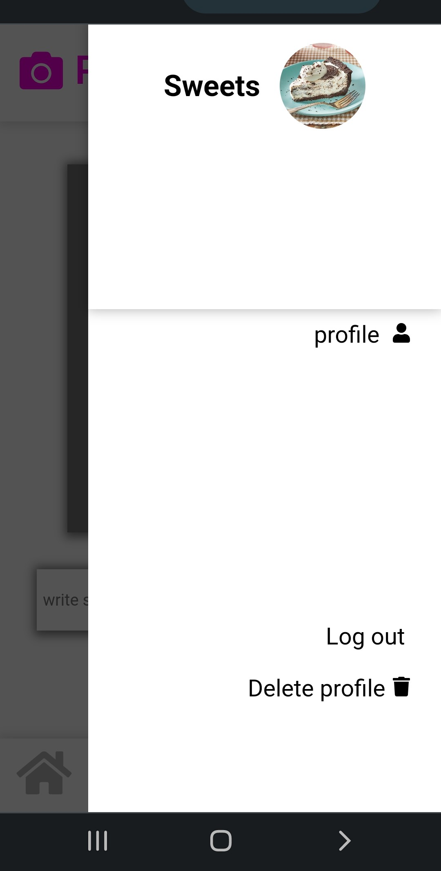
Menu
from the menu the user can:
Access his profile page
Disconnect from the website
Erase his account

Slide 7
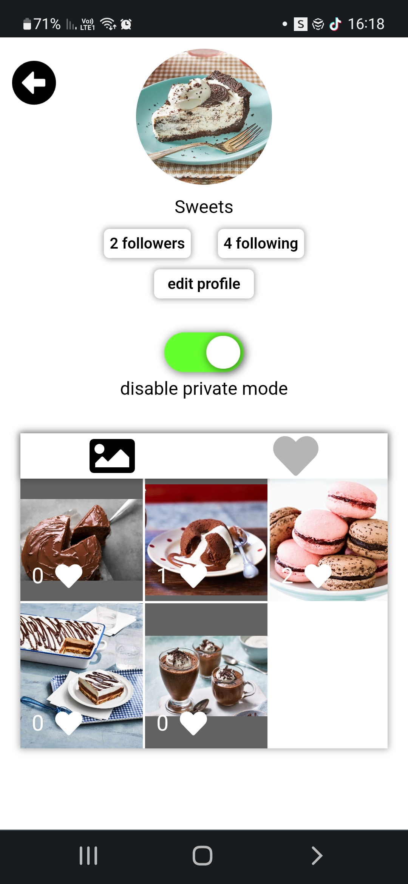
Profile page
On the profile page the user can
Edit his profile (by changing his username and profile picture)
Change his profile to private or to non-private.
Look & search at his followers and followers.
This page contain all the user posts and all the posts he liked
The number of followers of the user changes in real time

Slide 8
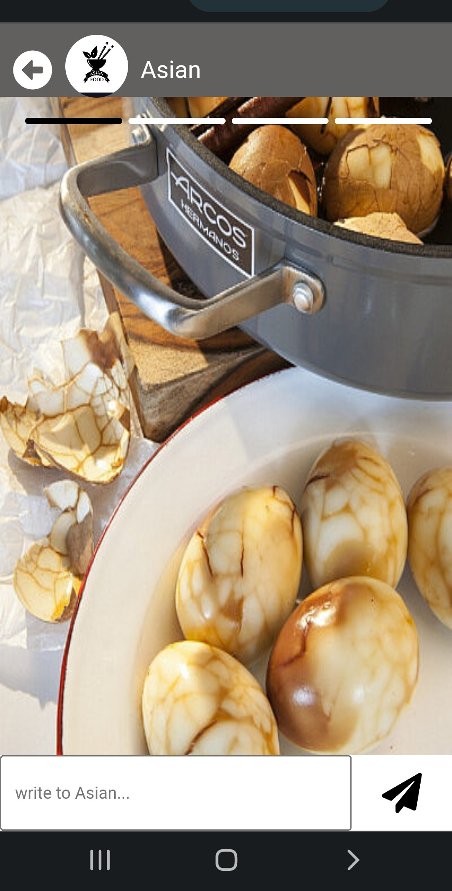
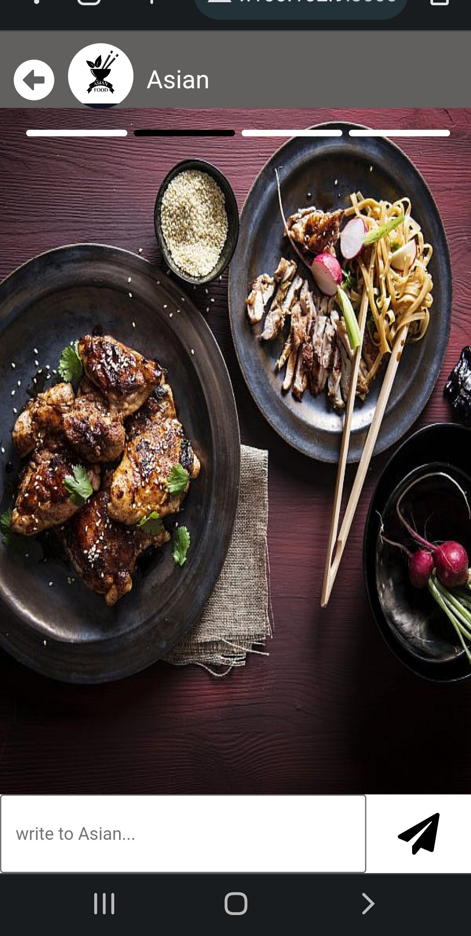
Story feature
The user can switch between stories by clicking on the screen.
clicking the right half of the screen -> go to the next story
clicking on the left side of the screen -> return to the previous story
Every story uploaded will disappear from the site after 24 hours
Only the user who uploaded the story will be able to delete it before

Slide 9
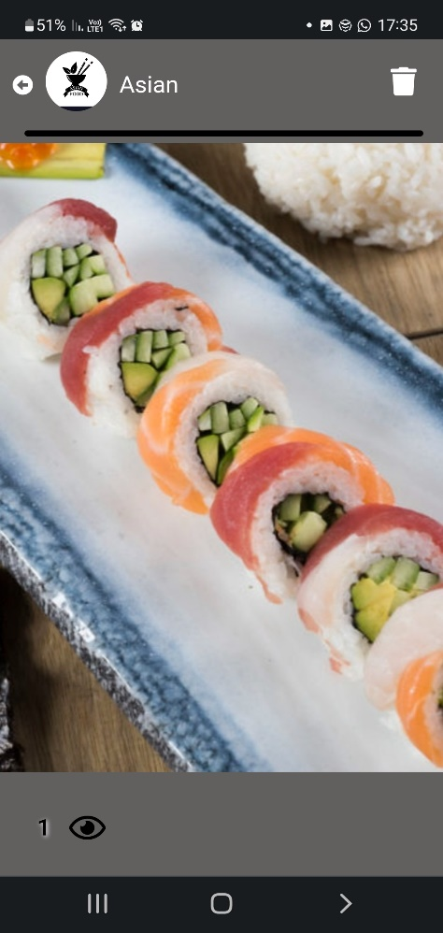
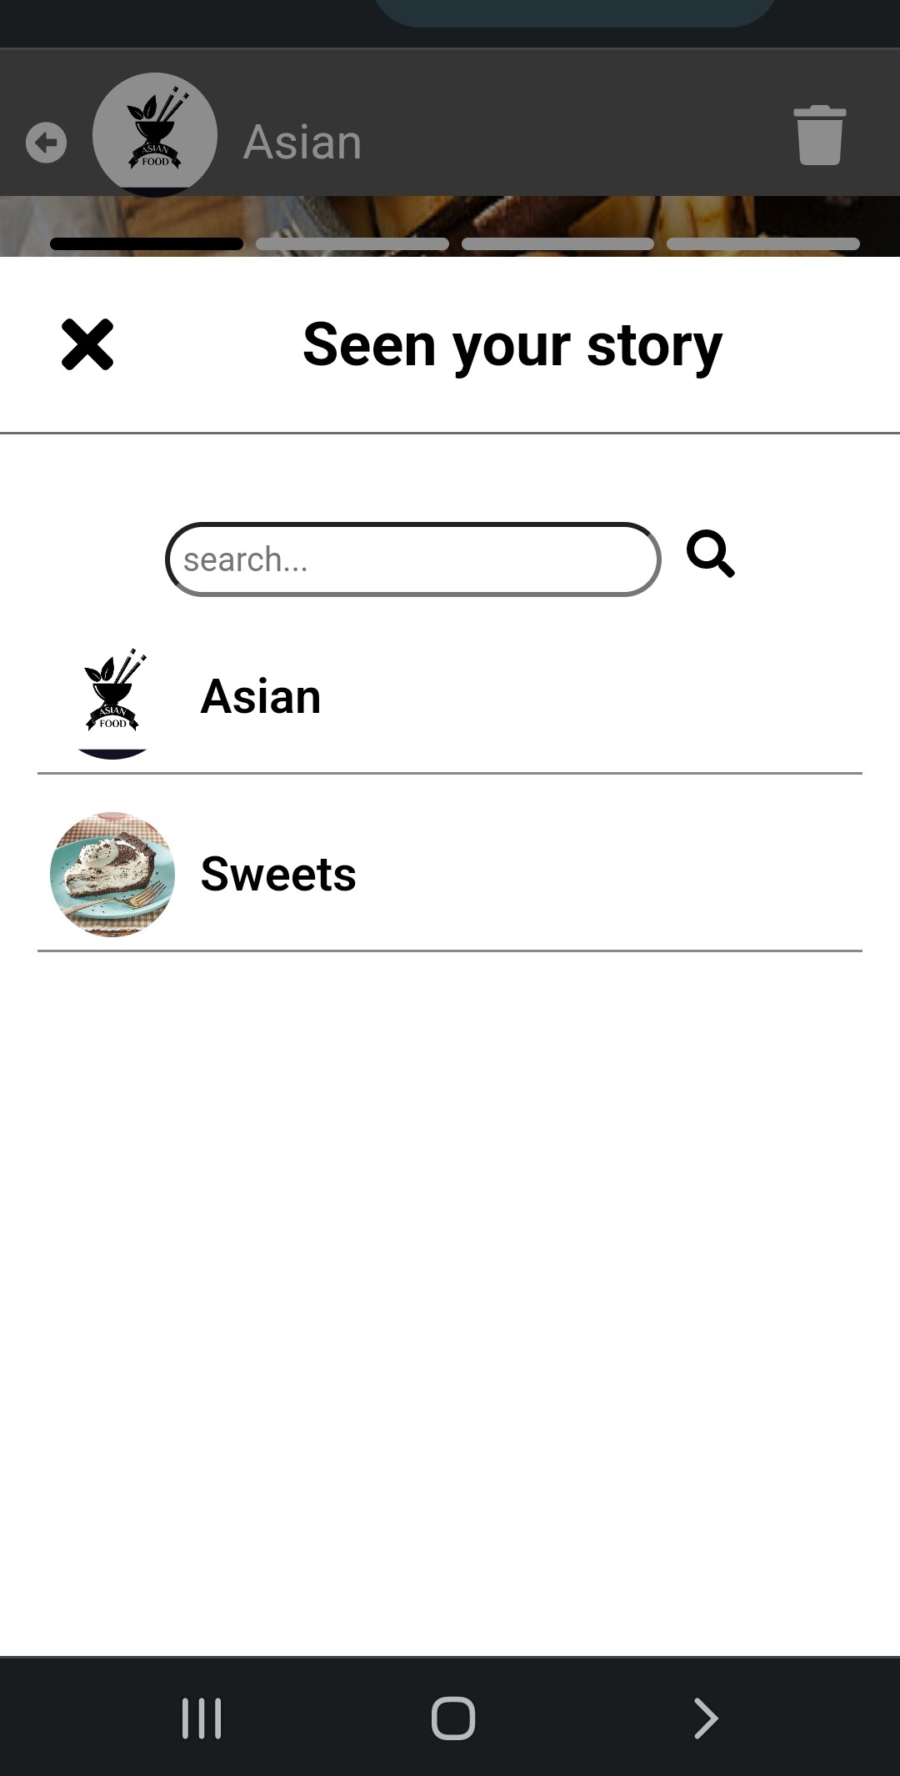
Seen your story
User that upload a story has the ability to see who has viewed it.

Slide 10
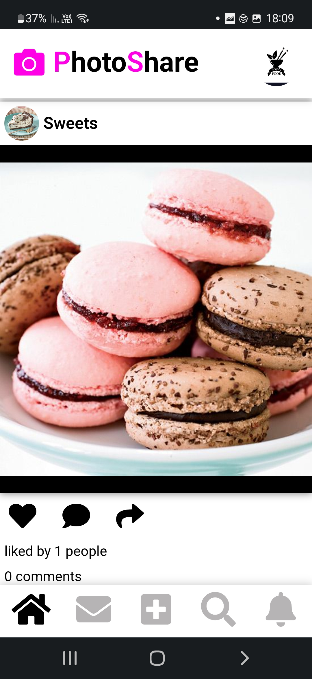
Posts
At the home page, in order to see his following’s posts the user can scroll down.
The posts are arrangeg chronologically (newest first)
Every post has comments, likes and share sections

Slide 11
Comments
Each post has a comment section
The user who uploaded the post can delete any comment they want, other users can delete only their own comments
The user who uploaded the post receives notifications in real time about comments written in his post
There is an option to reply to a specific commwnts by clicking the “reply” button. The user will be notified of any response to his comment.

Slide 12
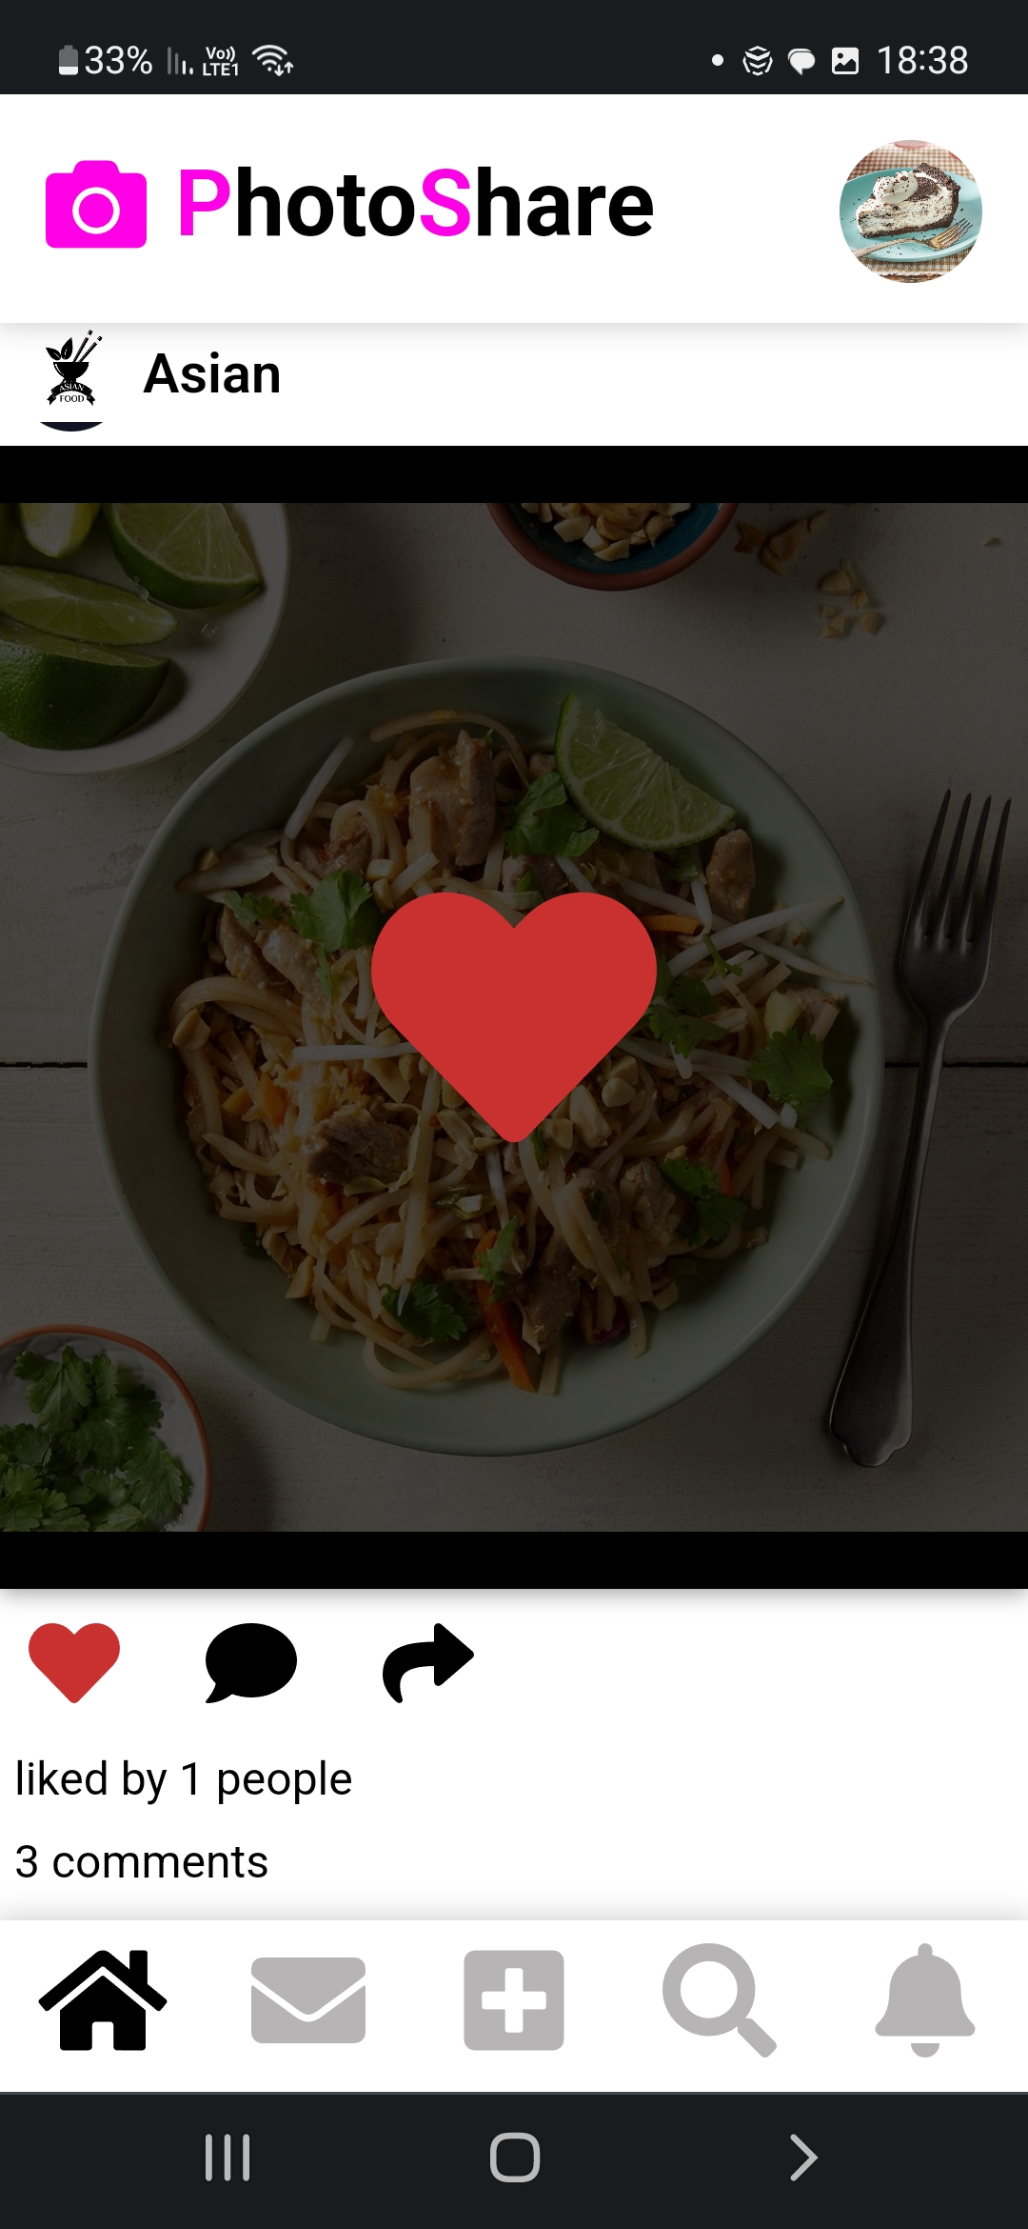
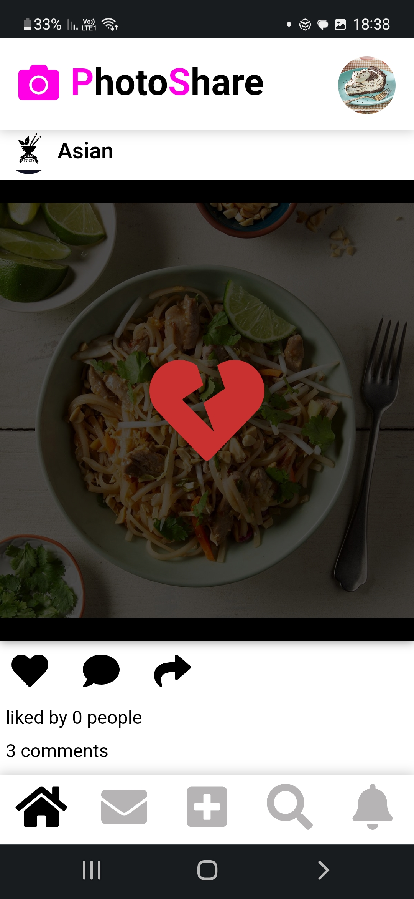
Liking post
User can like a post by double-clicking on it or by clicking on the heart icon
If a user has liked a post they can undo it by double-clicking the post again or by clicking the heart icon again
The number of post’s likes changes in real time and the user who uploaded the post receives a real time notification.

Slide 13
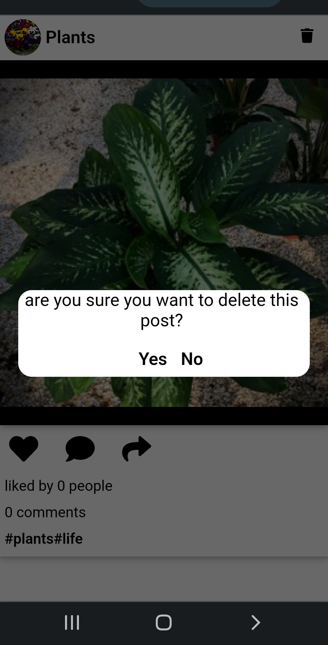
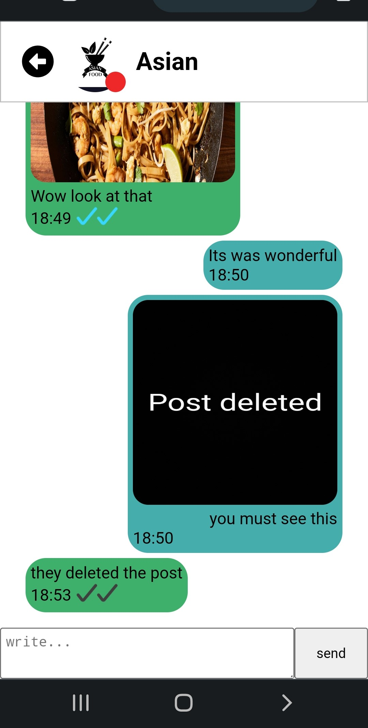
Delete post
Any user who has uploaded a post can delete it by clicking on the trash icon at the top right of the post
After deleting a post, it will be deleted from everywhere on the site including conversations of other users

Slide 14
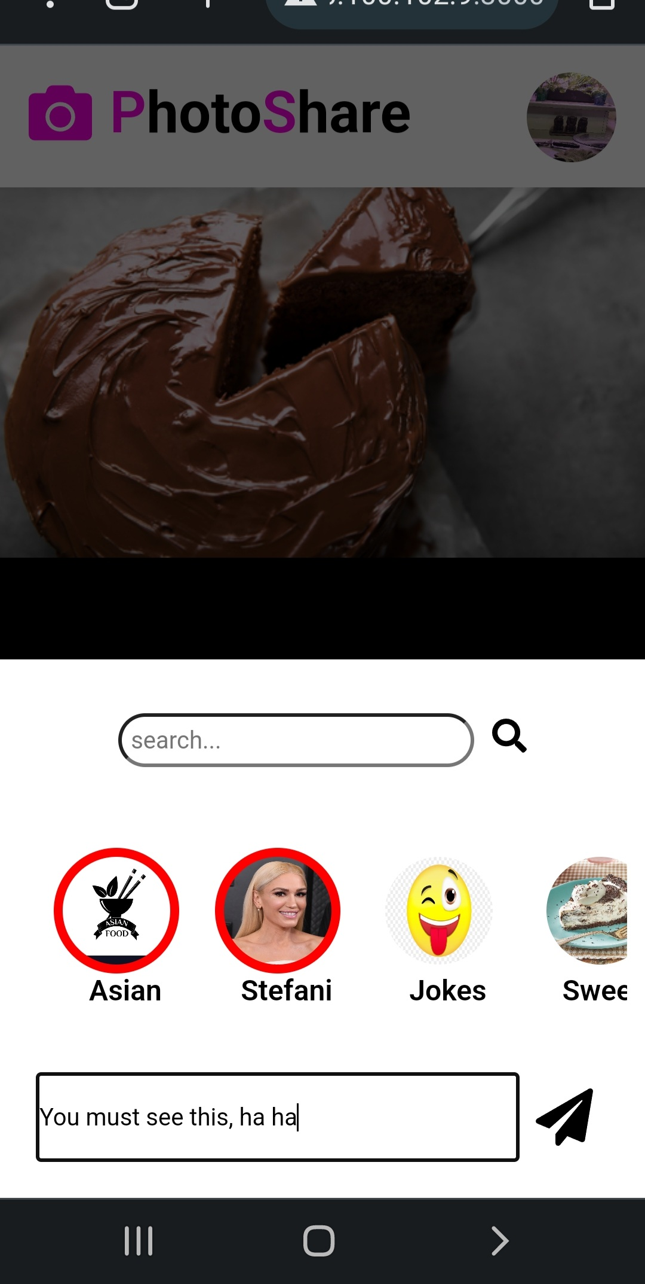
Share post
Users can share posts by clicking on the share icon. they can choose which users to send the post to and add a verbal message
The user can share the post to a multiply users by clicking on the profile picture. Users circled in red will receive the.

Slide 15
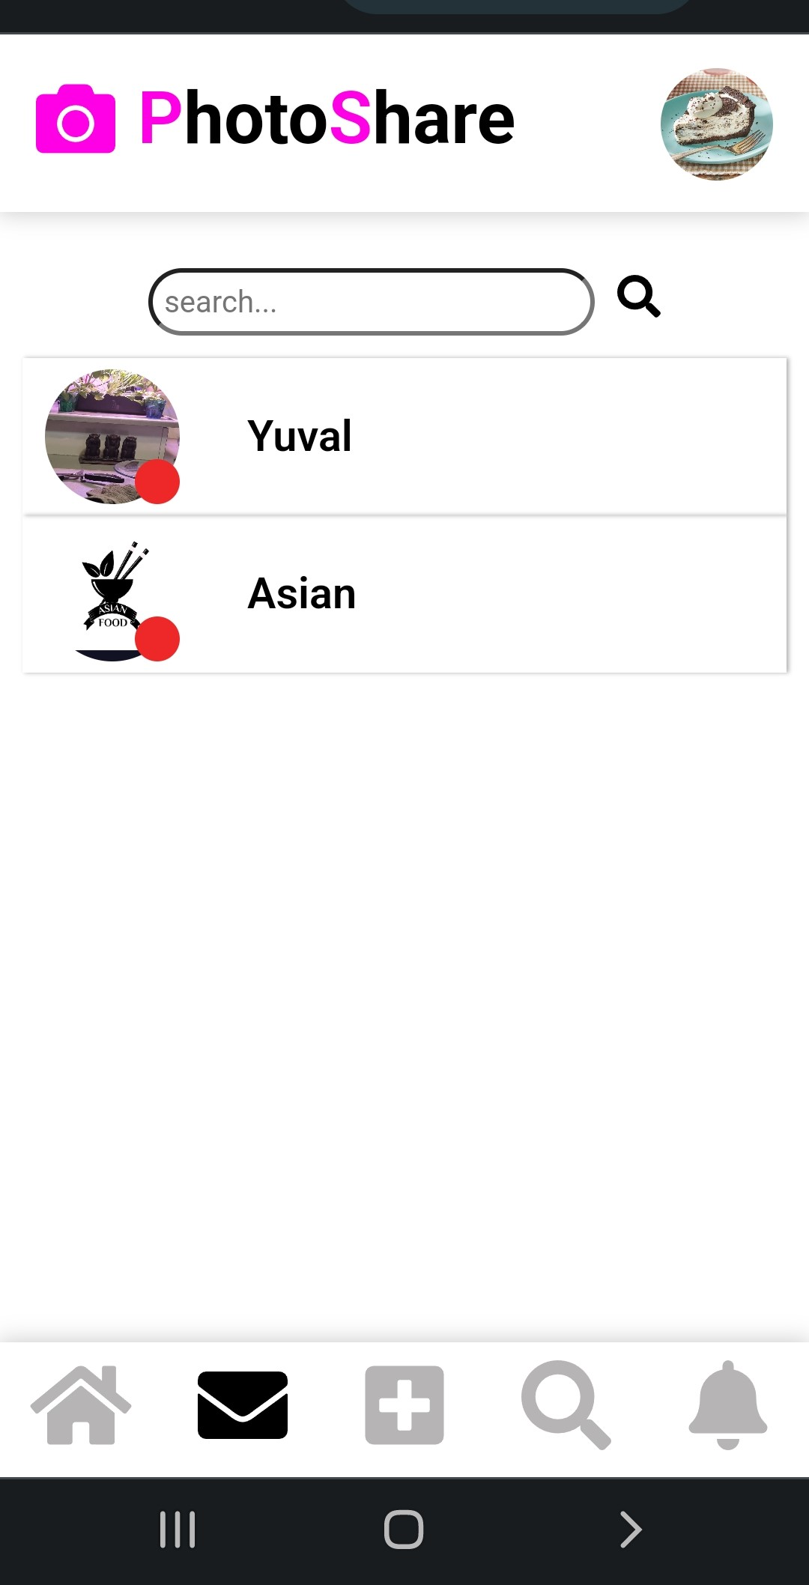
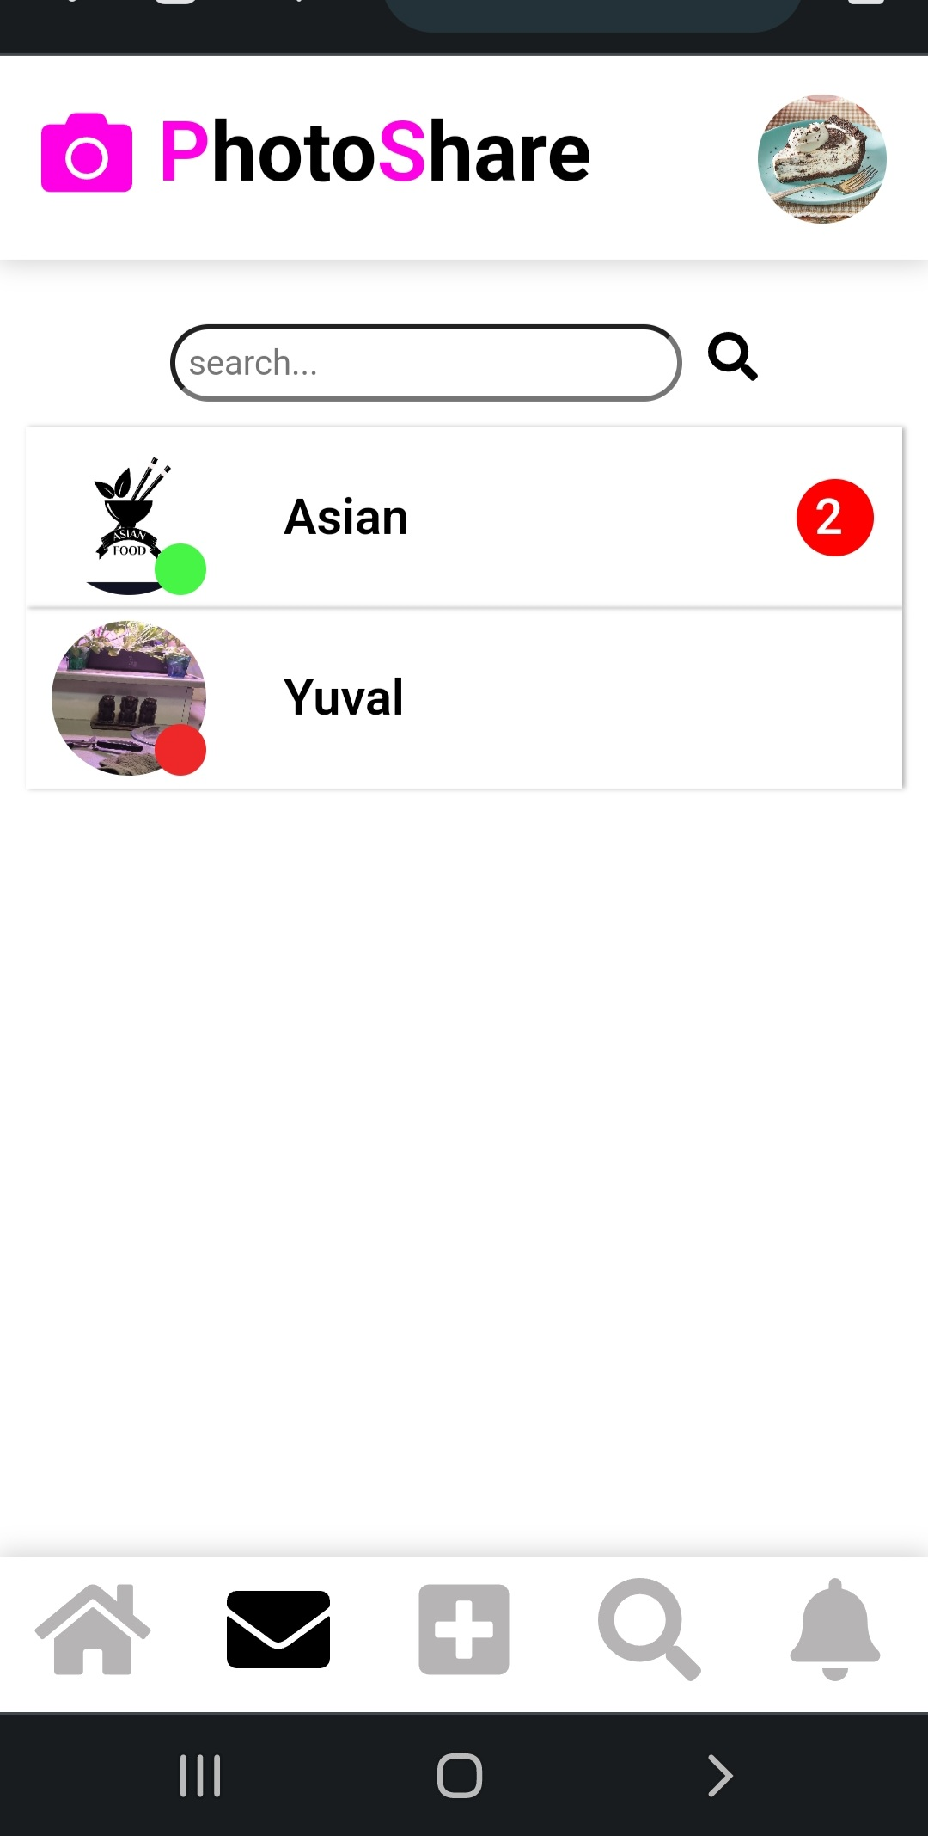
Chats page
The chats page shows all the conversations the user has with other users
the conversations arranged in chronological order so that the most recent conversation at the top.
Next to each profile picture of a user there is a circle, the circle is colored
Red - when the user is not connected to the site
Green - when the user is connected to the site
**the color of the circle changes in real time
The number of unread messages is displayed on the right side of the chat.

Slide 16
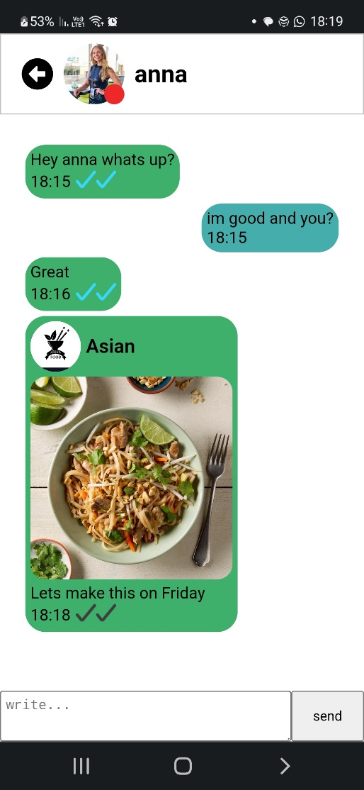
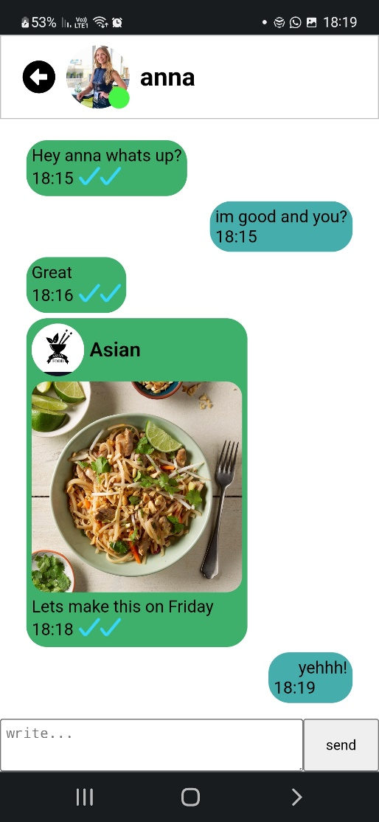

Chat page
Each user has a unique perspective on the conversation according his sent messages and received messages.
Every message includes
the time it was sent
a symbol of two 's that is tinted blue when the user who got the message has viewed it
The users receive the messages instantly.

Slide 17
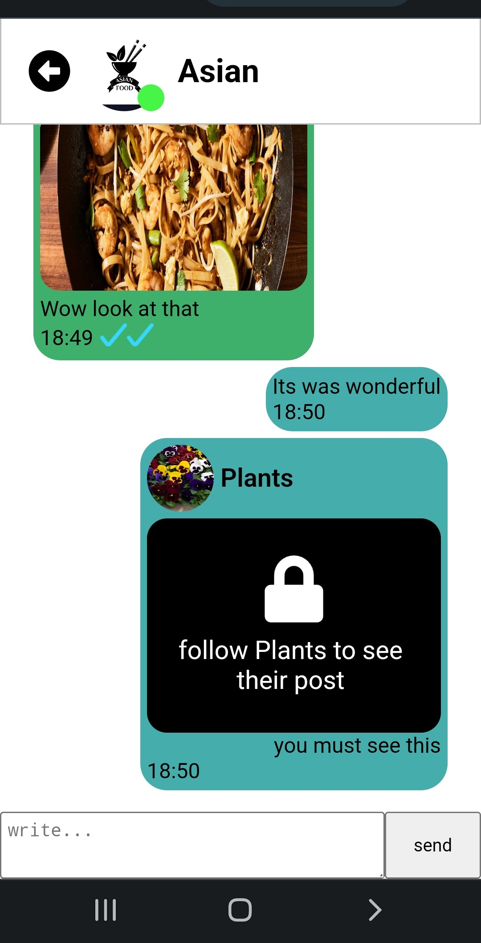
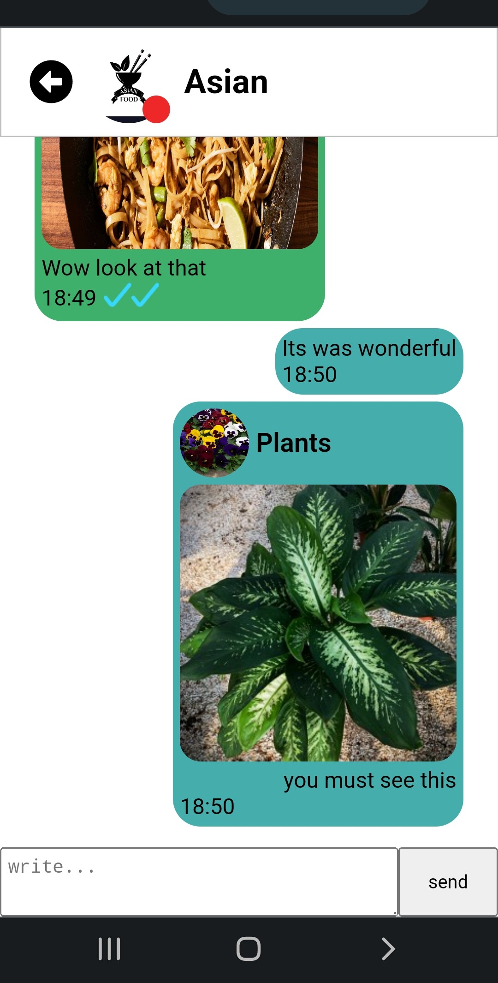
Chat page
if a user transmits a post from a private user to another user who does not follow the user who submitted the post - he wont be able to view the post in the chat

Slide 18
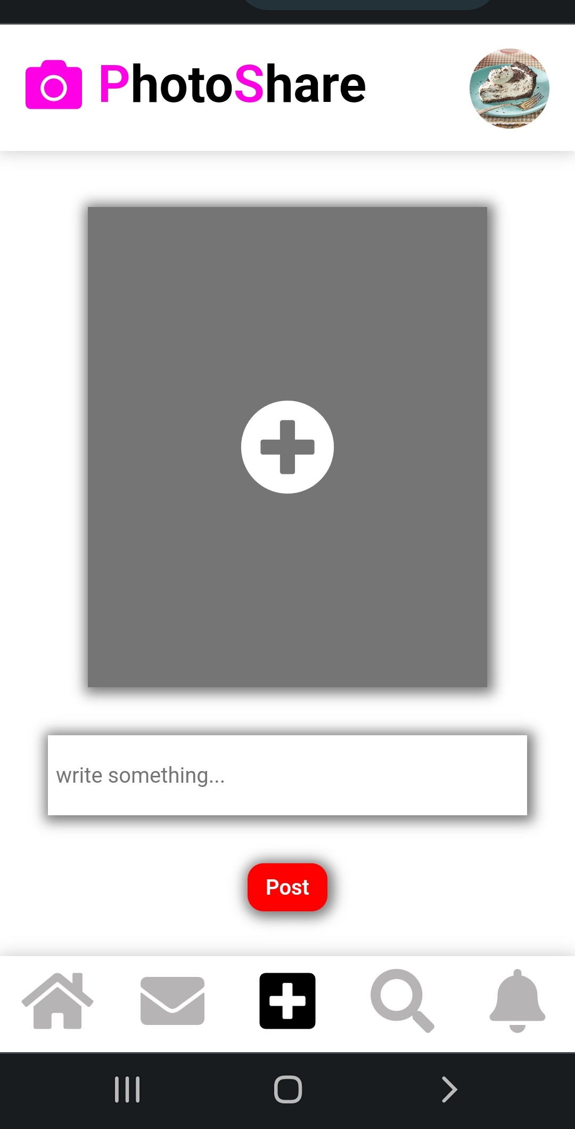
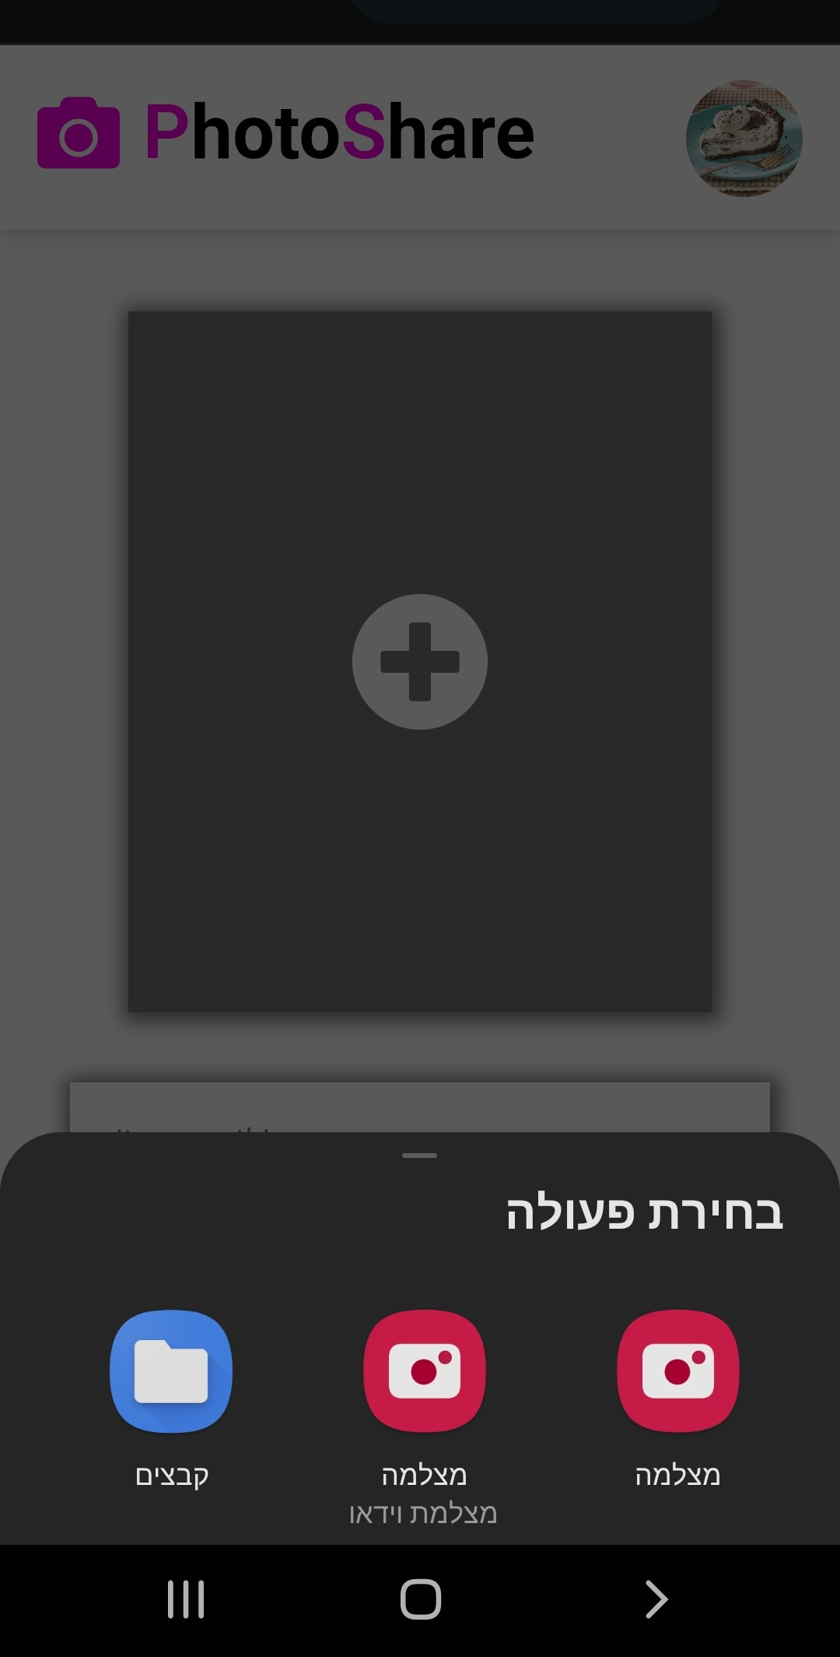
Adding post
On the “add a new post page”, the user chooses which image to upload and can add a sentence that will appear at the bottom of the post

Slide 19
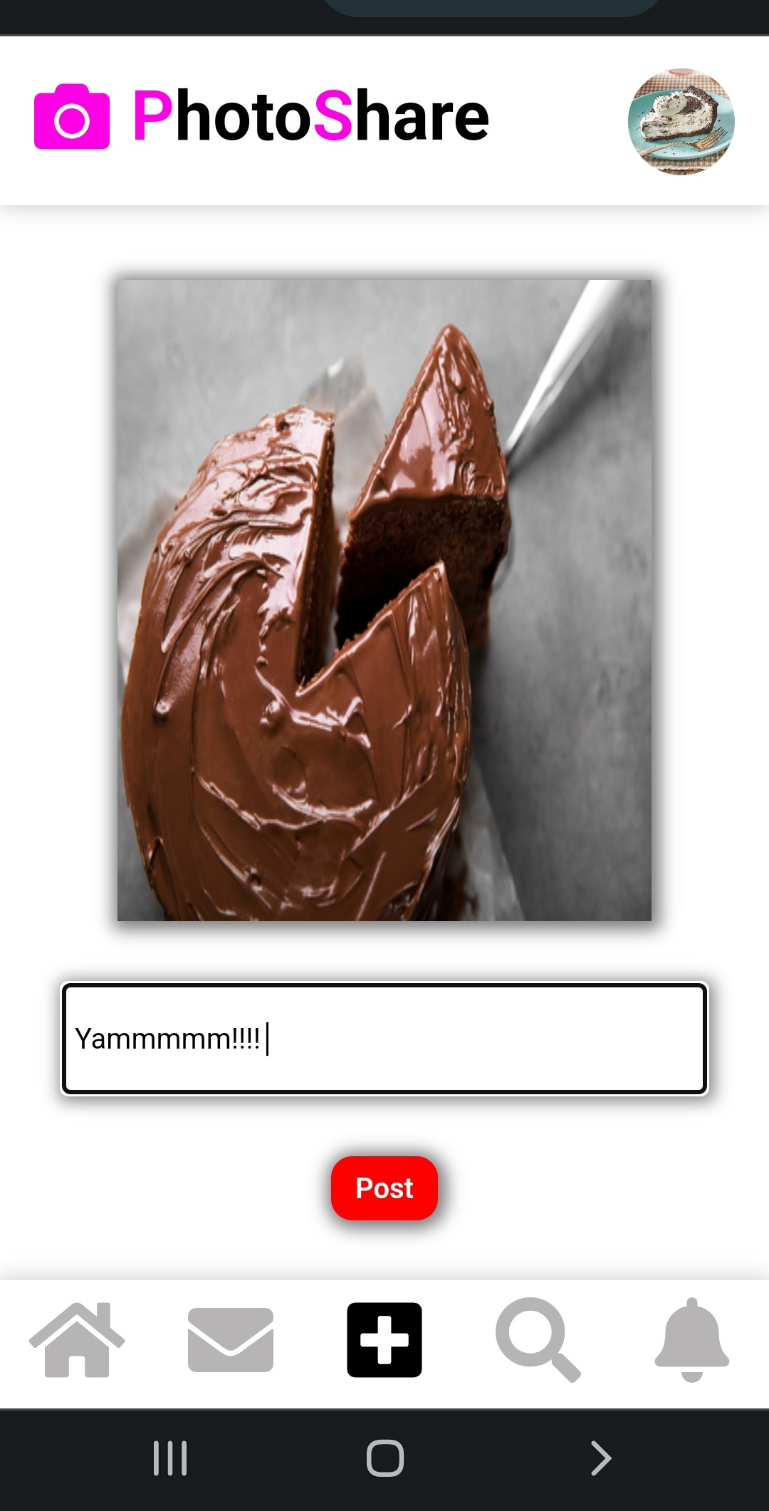
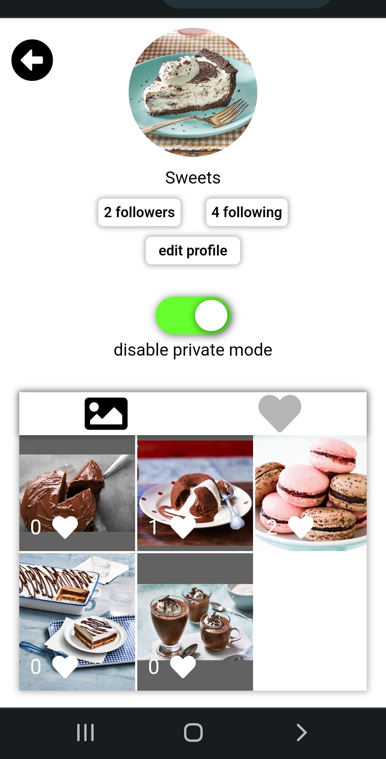
Adding new post
After the post update, the user will be taken to his profile page where he will be able to see the new post at the beginning of his posts section

Slide 20
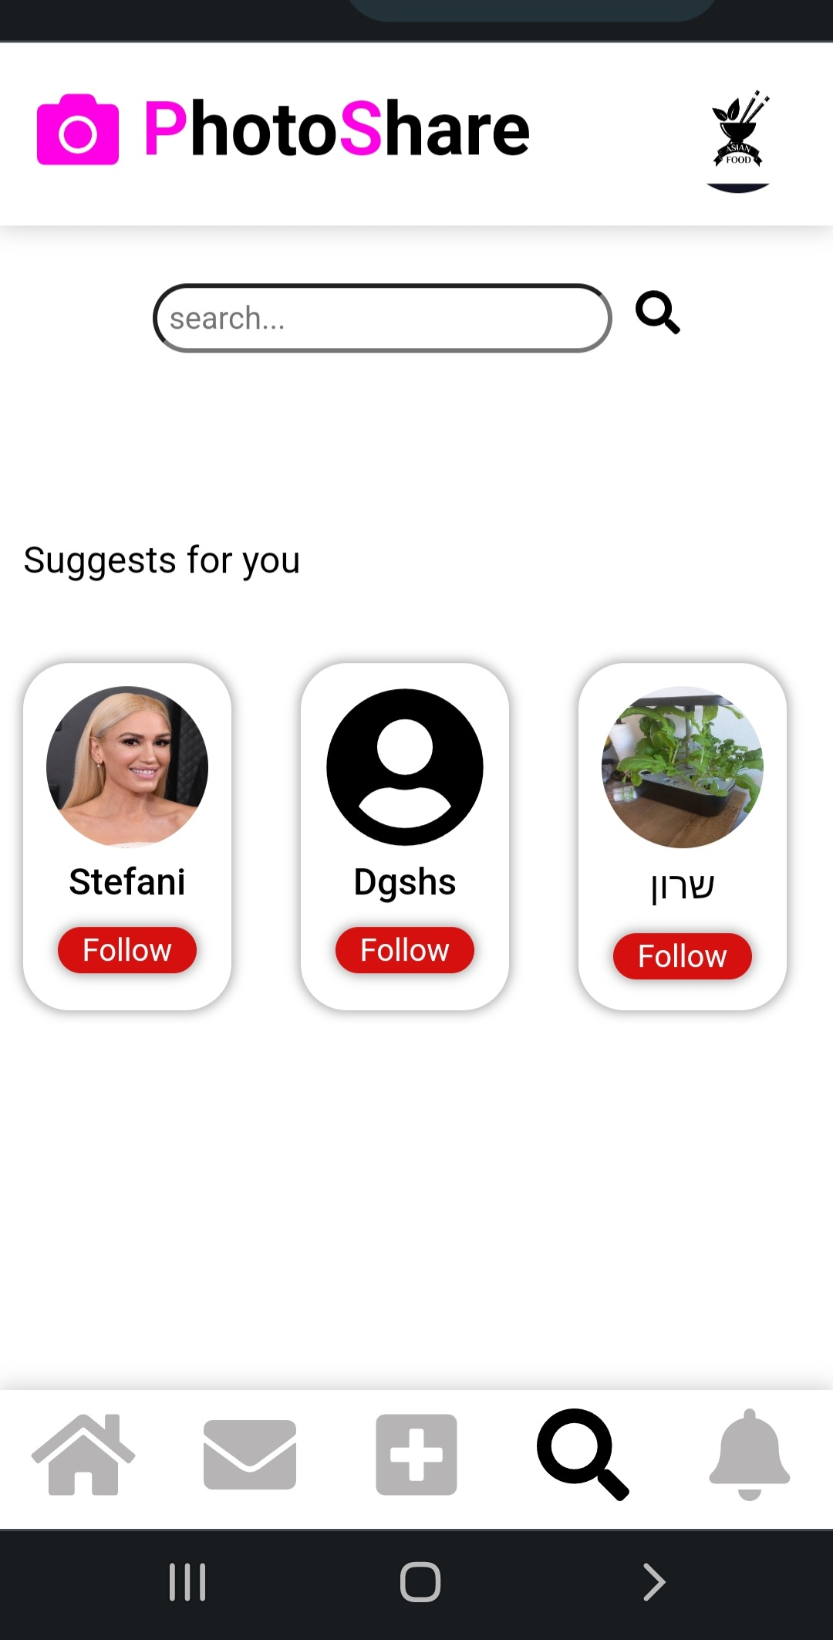
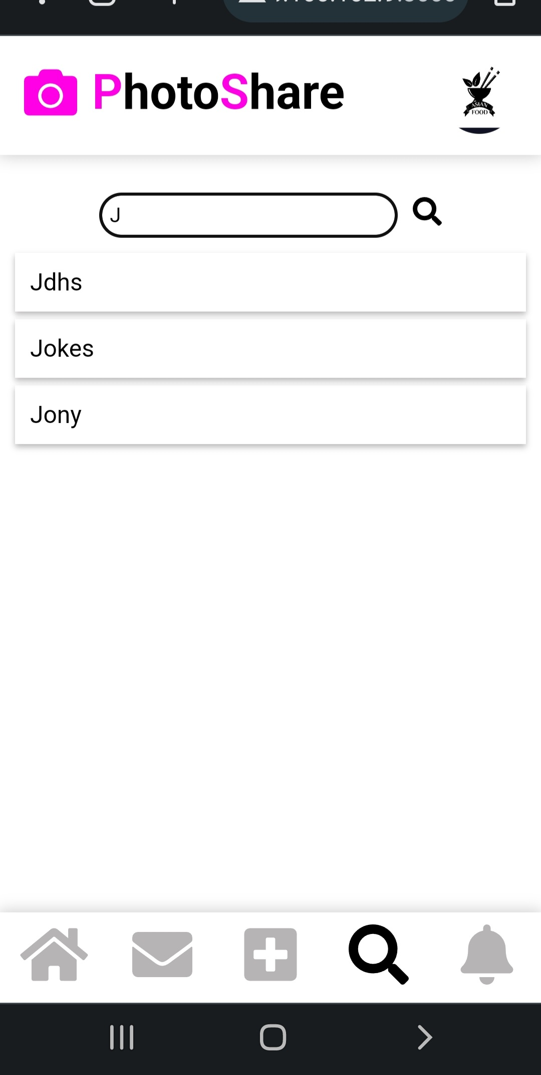
Search page
On the search page, user can search for any user that exists on the site
After a user has searched for another user they can click on them in the search list and go straight to their profile
As long as the search bubble is empty, a list of suggests users appears. The list includes other users on the site that the user does not follow or has not yet requested to follow them
After the user requests to follow a user from the suggested list, the suggested user will disappear from the list

Slide 21
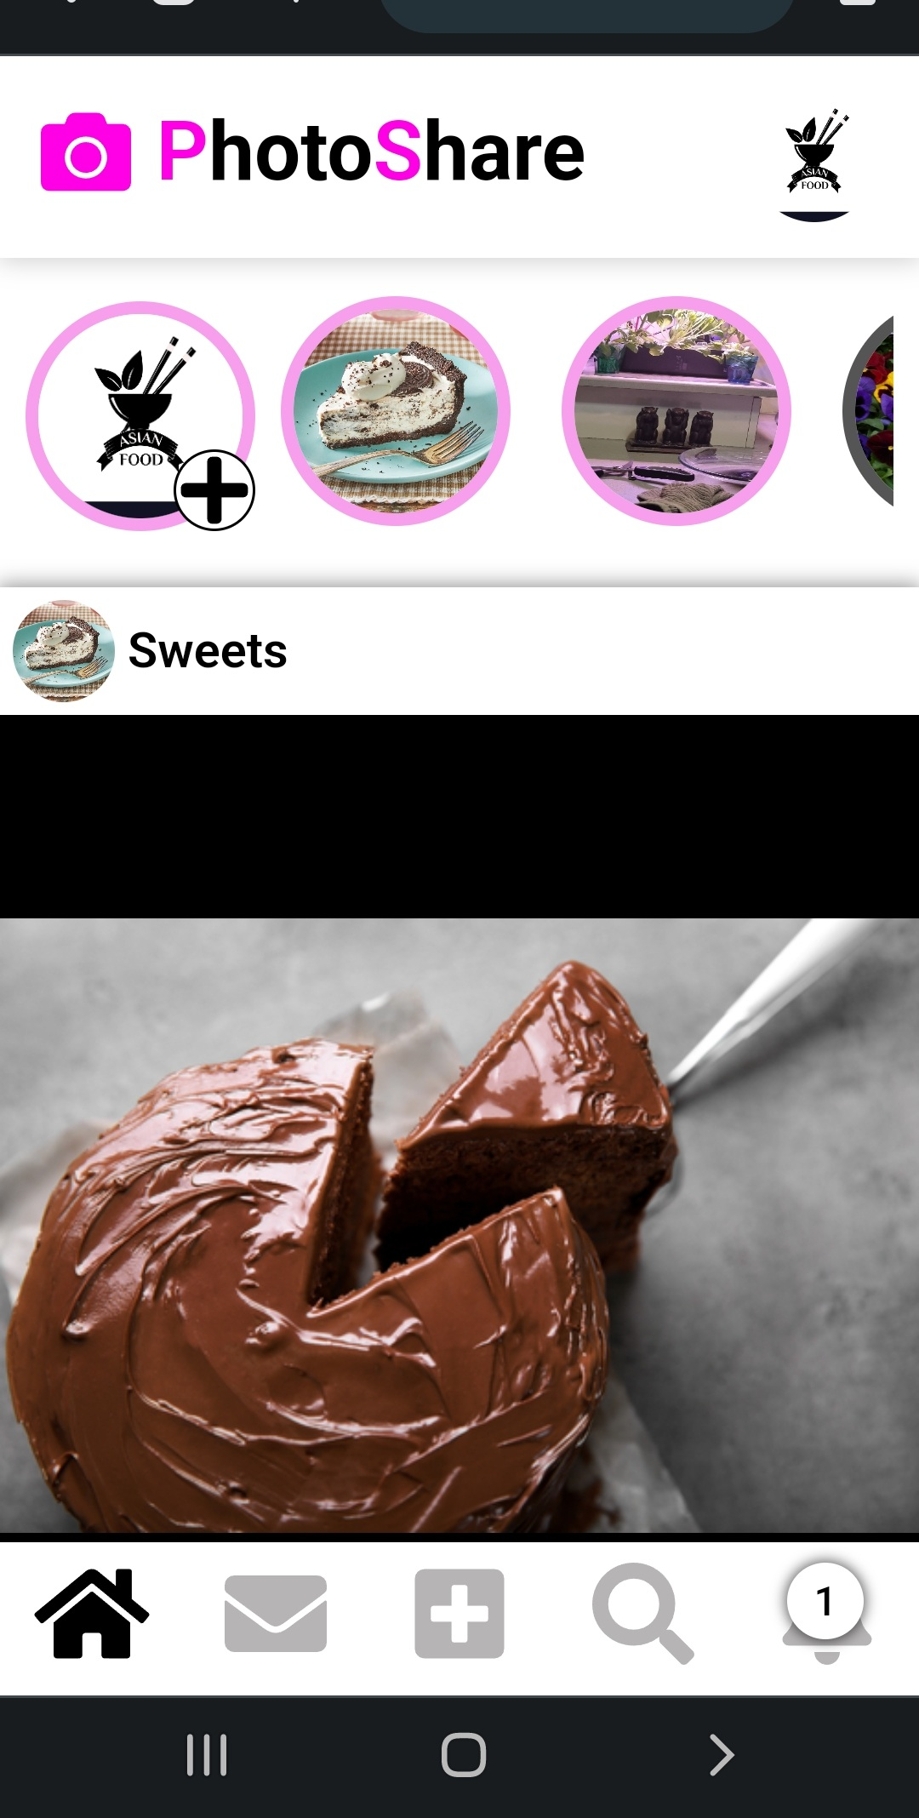
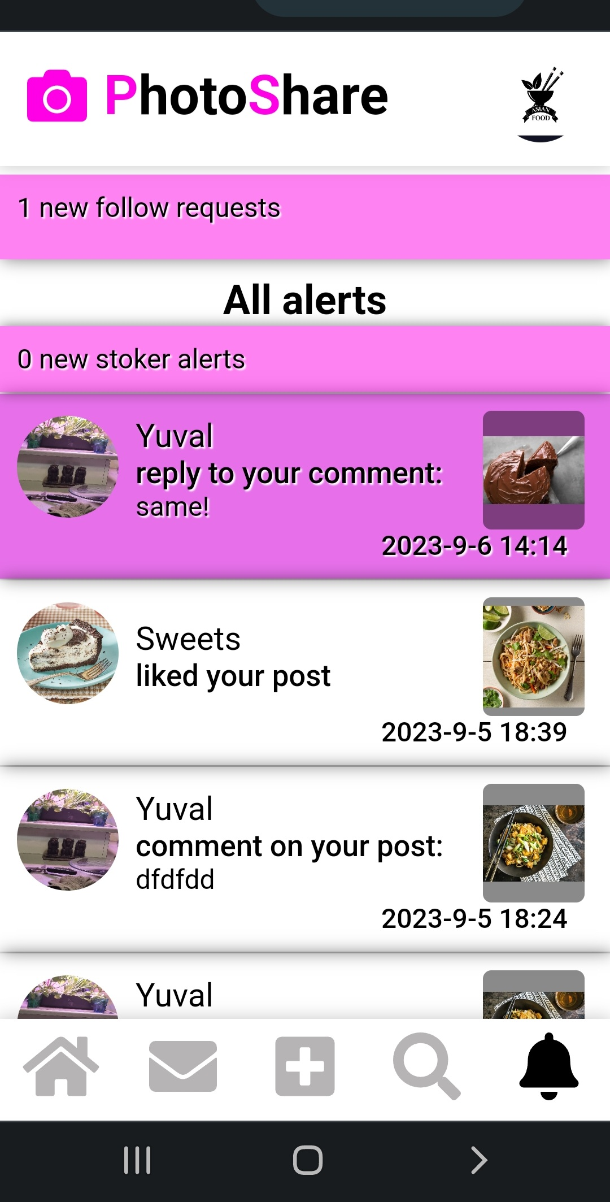
Notifications
The notification icon changes (in real time) to reflect the arrival of a new notification and the total number of unread notifications.
On the notifications page, the user receives post’s notifications and new follow requests
The notifications are arranged in chronological order (newest first)
All the brand-new notifications that haven't been viewed are highlighted in pink for one second.

Slide 22
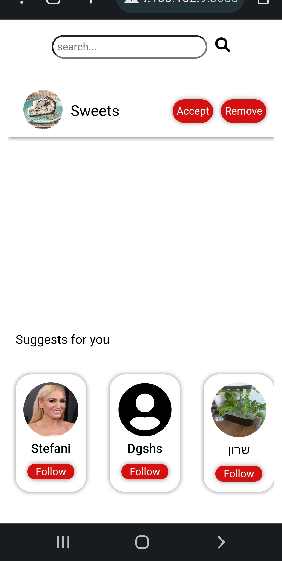
Follow requests
Follower requests will only appear to users set as private
By clicking on the “new follow request” in the notification page, the user will be transferred to a page with list of follow request
By clicking on one of the request, the user will be transferred to requesting user's profile
The user can approve or decline the request, then the request will disappear from the list
The request will remain in the list as long as the user does not do anything with it

Slide 23
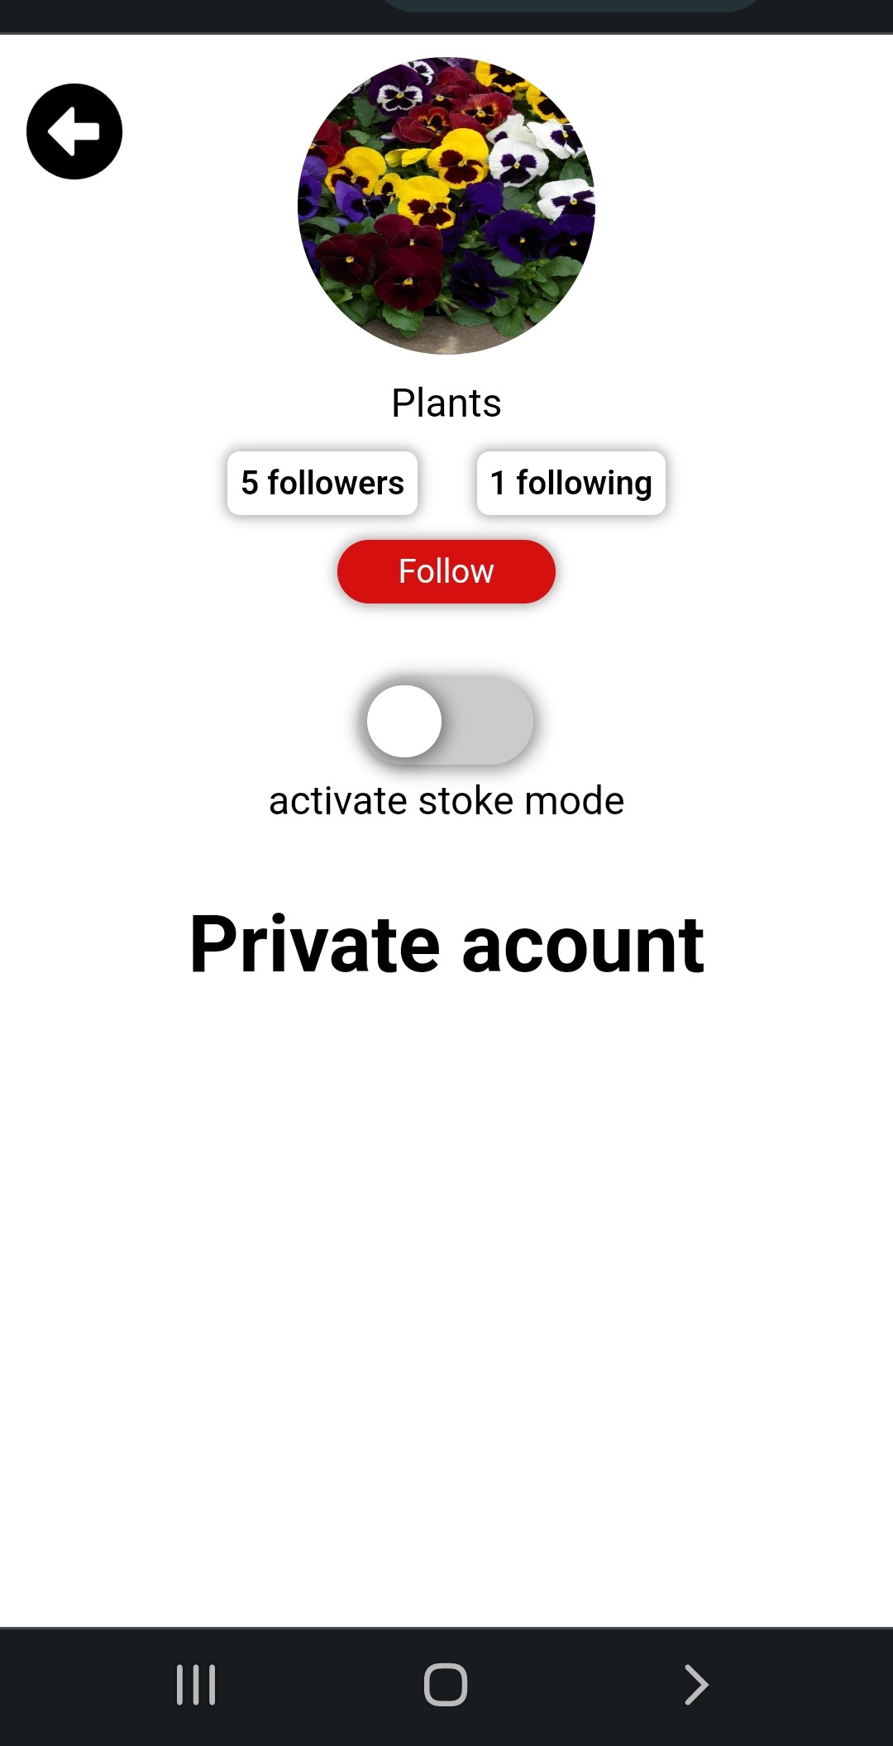
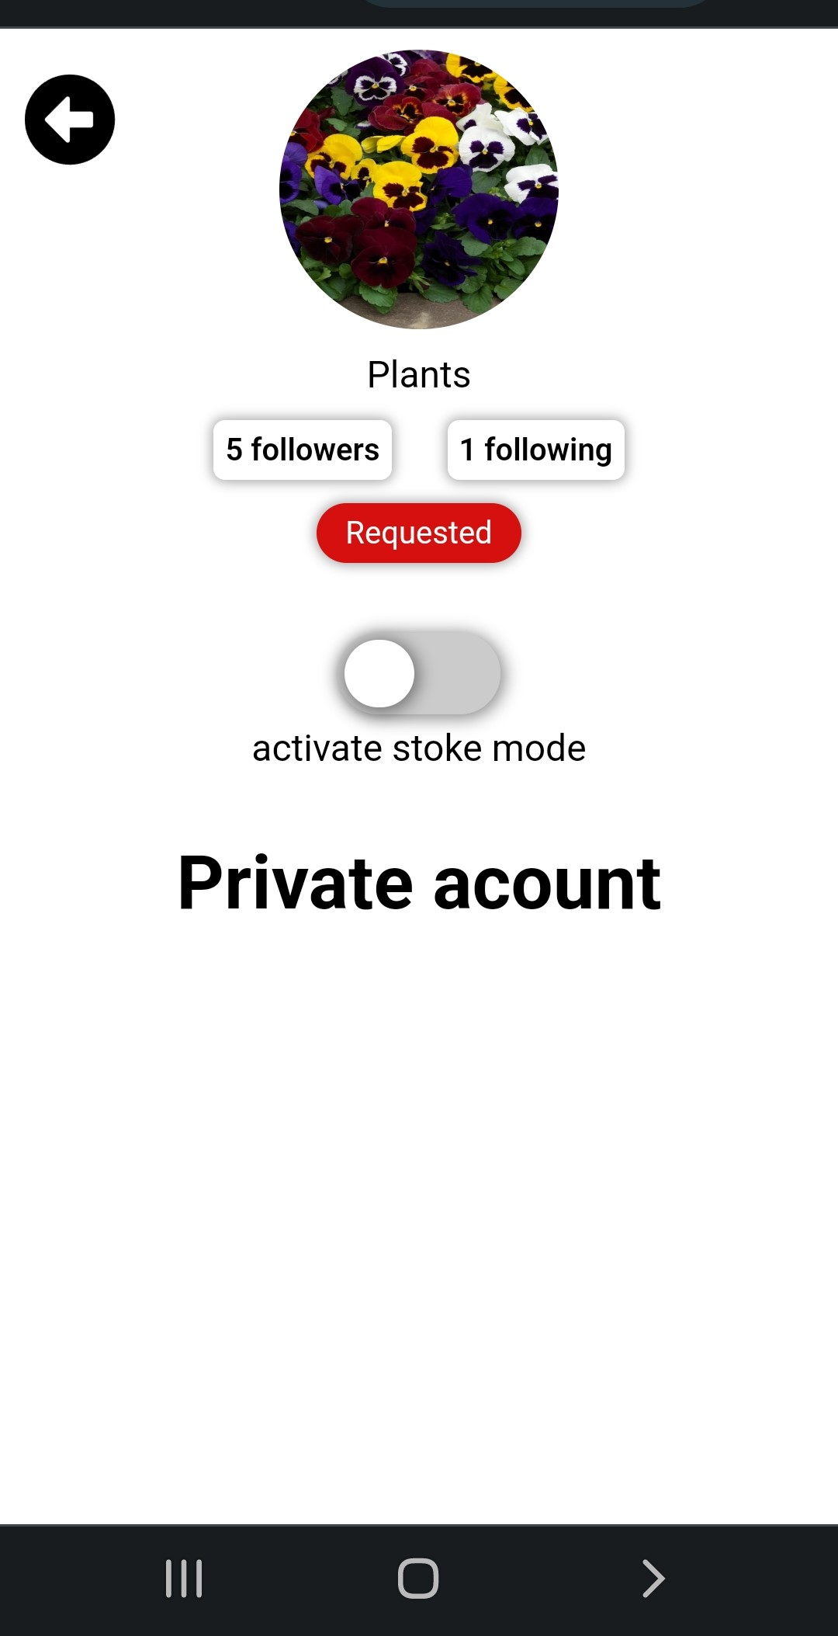
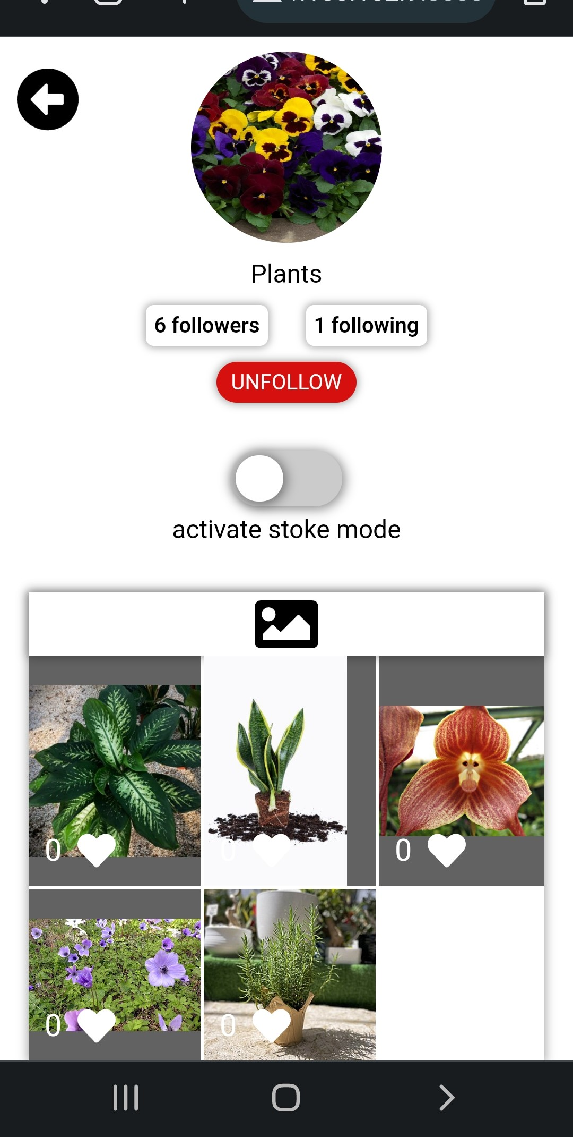



Follow requests

Slide 24
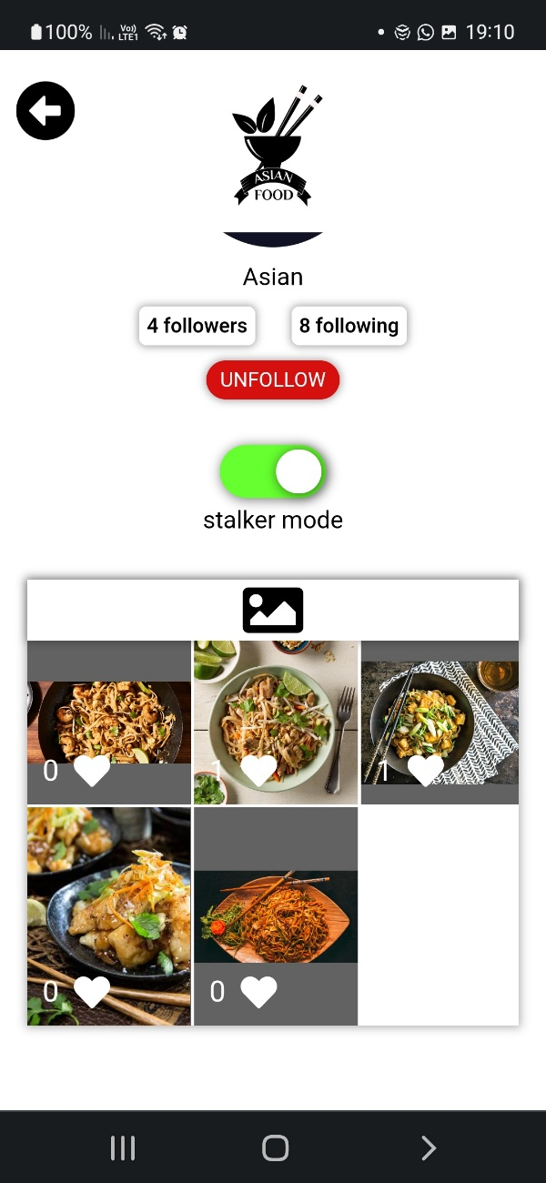
Stalker mode
“Stalker mode” is my special feature that aims to reveal stalkers of the user (and add some “spice” to my social network)
Each user can activate the feature on a maximum of 2 users.
After a user has decided to activate the feature on another user, The user will receive a real time notification every time the “suspected stalker”:
Looks at his page
Enters a certain post
Reads the comments on the user post

Slide 25
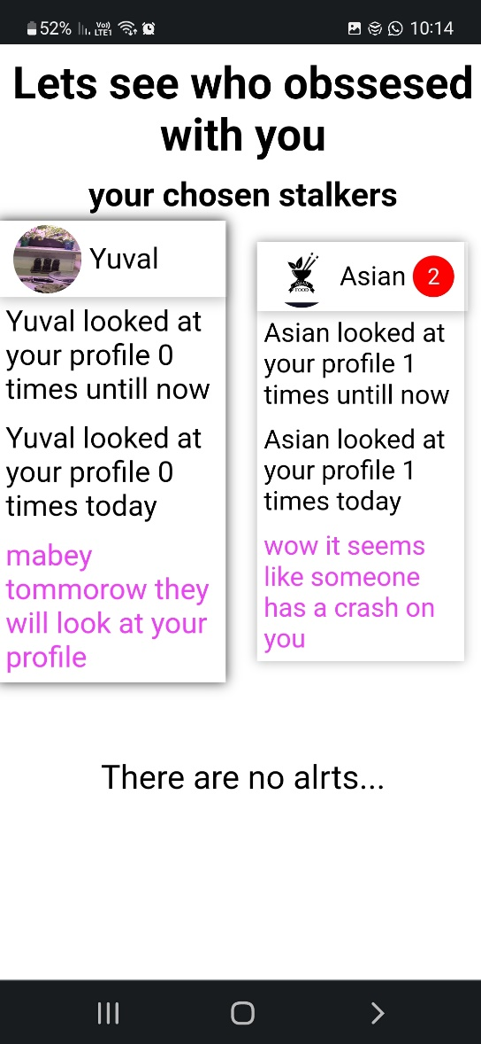
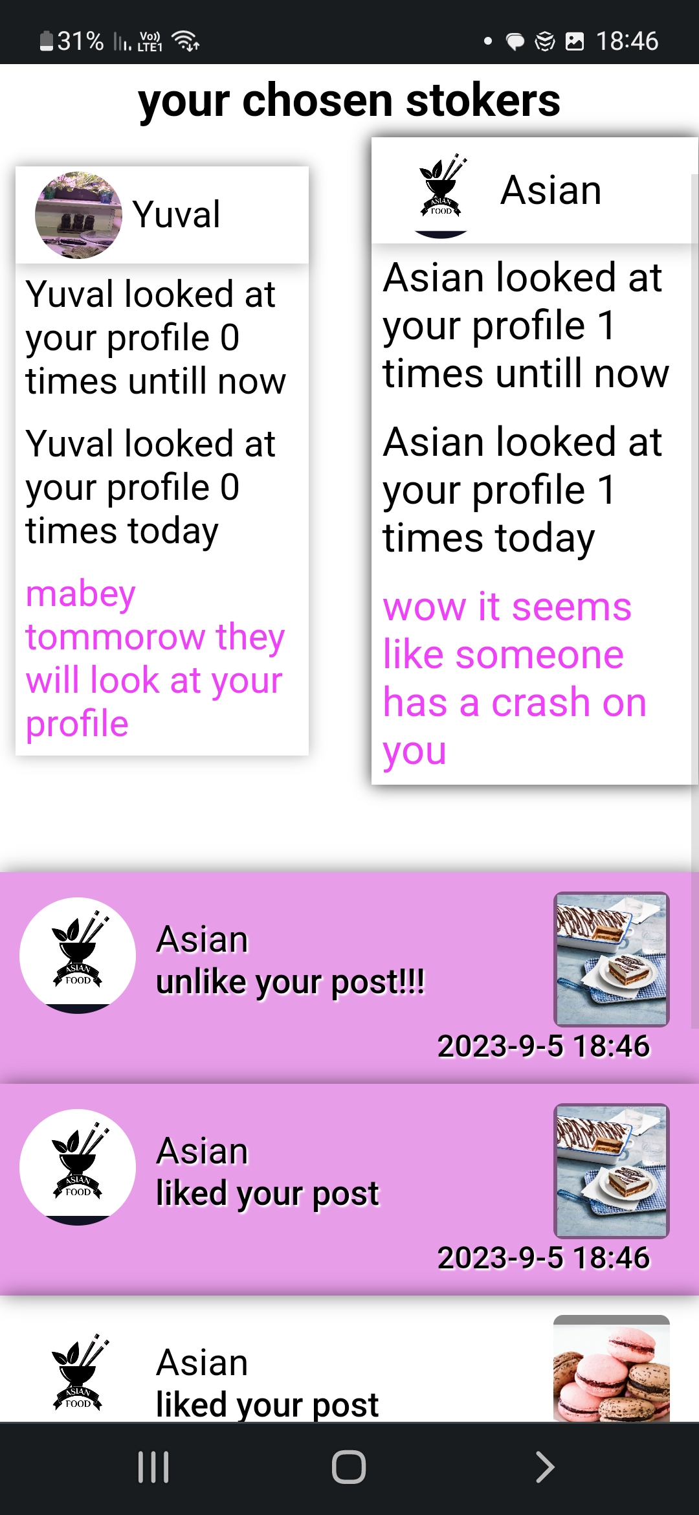
Stalker alert
Access to the “stalker alert page” is through the notifications page.
on the “stalker alert page” ,After clicking on one of the “suspected stalker” the user will see all the notification from this specific “suspected stalker” .
Notifications that have not yet been seen will be highlighted in pink for one second
The alerts are arranged in chronological order (newest first)
The purpose of the feature is to create more interactions between people on the site. with the help of this feature, people will be able to find out who has a crush on them and maybe start new conversations.
A new suggested interaction – now user can enter multiple times to the profile of a user they guess activated the feature on them in order to attract their attention

